Slide 1
An Inconsistency Free Formalization of B/S Architecture
Qin Li, Huibiao Zhu, Jifeng He
East China Normal University

Slide 2
Motivation
Formalize the B/S architecture using CSP Method
Focus on several key interactions between browsers and servers
Analyze the consistency property of the formal model

Slide 3
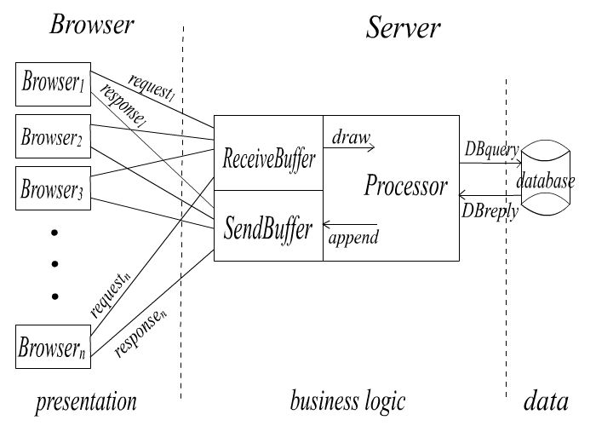
Framework

Slide 4
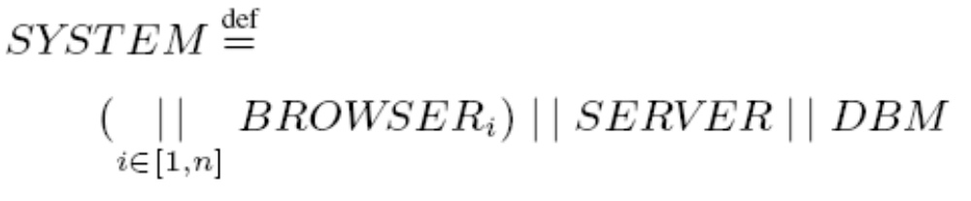

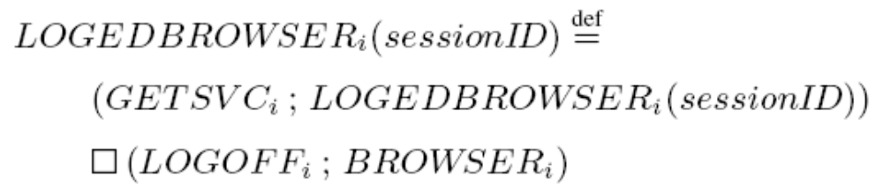
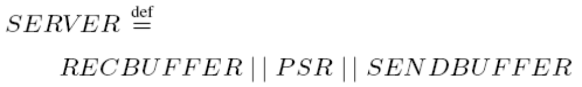
Formalization

Slide 5
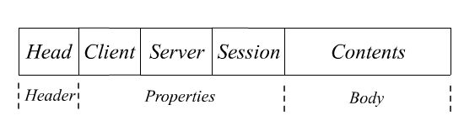
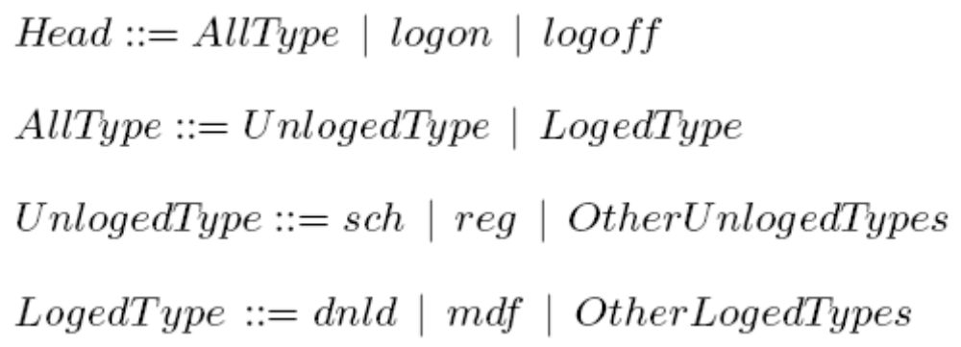
Message Types

Slide 6
Presentation Tier
Browser as user interface
Timer
Transaction generation

Slide 7
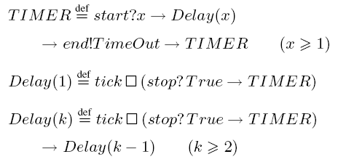
Timers
Starts when a browser sends a request to the server
Resets when timeout or receives server’s reply

Slide 8
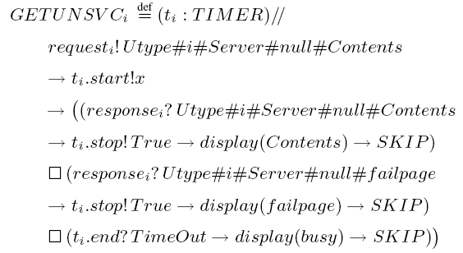
Transaction Generation

Slide 9
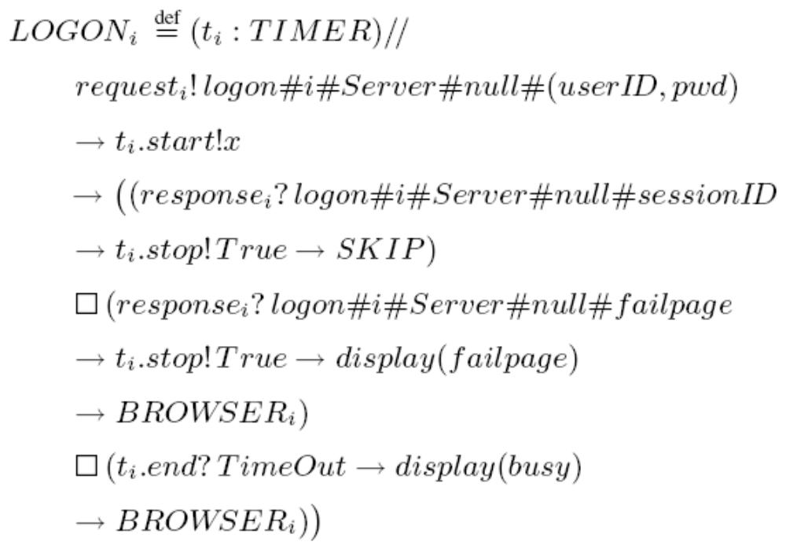
Transaction Generation

Slide 10
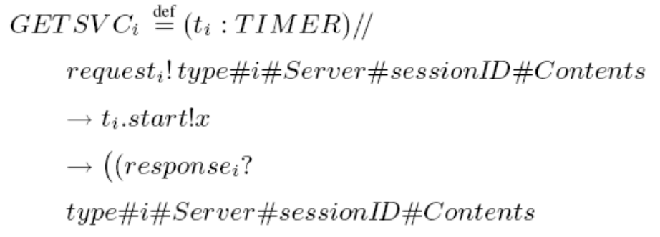
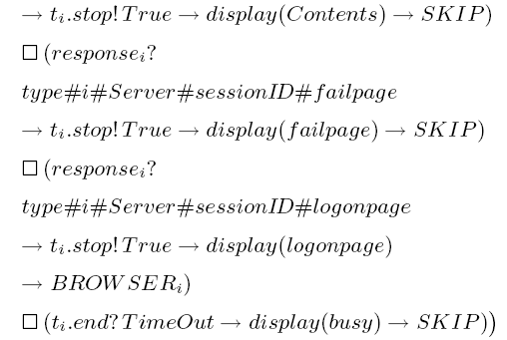
Transaction Generation

Slide 11
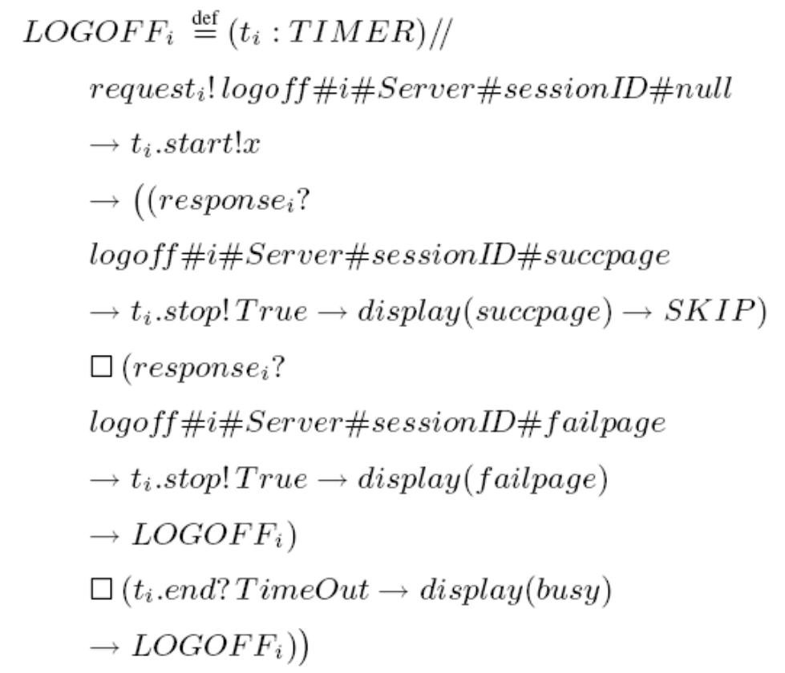
Transaction Generation

Slide 12
Business Tier
Buffers
  Receiving buffer
  Sending buffer
Server processor
Transaction processing

Slide 13
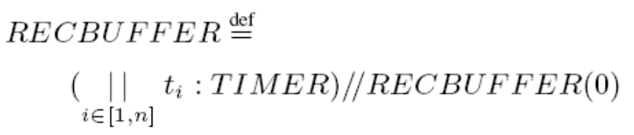
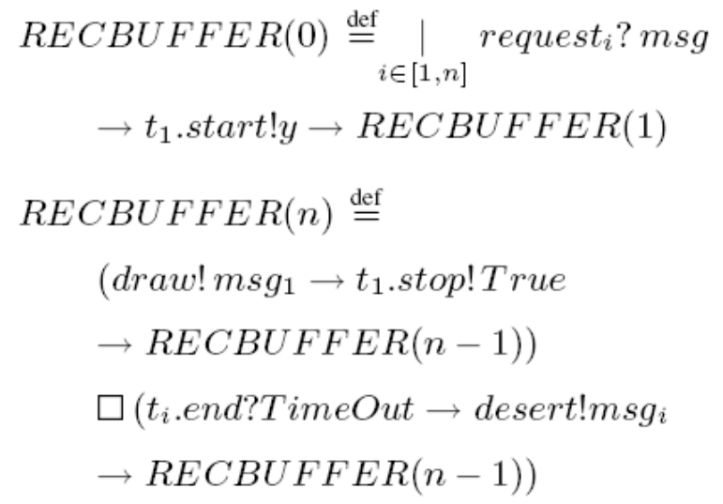
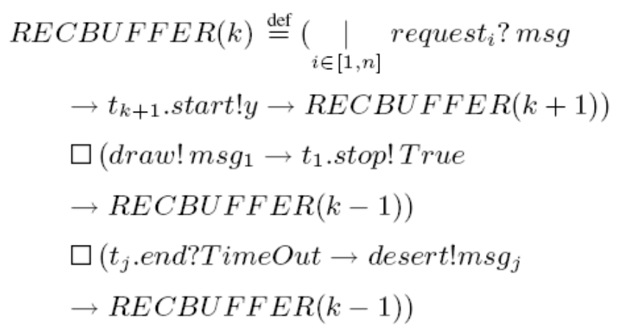
Buffers

Slide 14

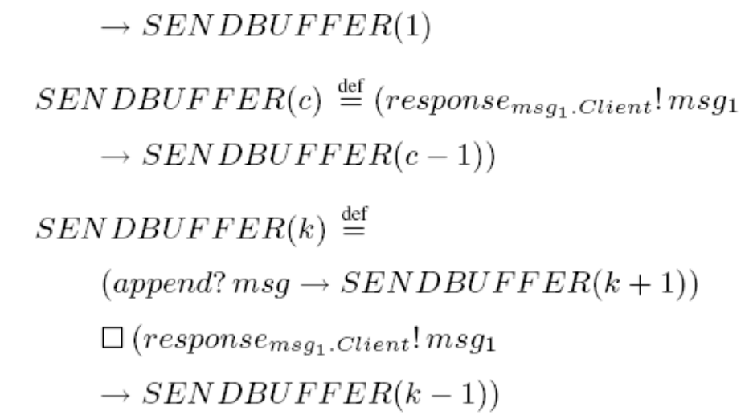
Buffers

Slide 15

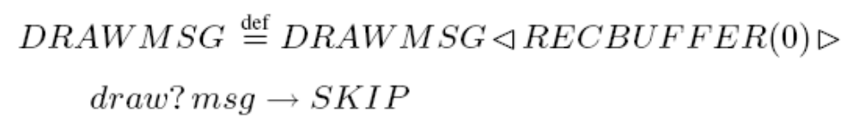

Processor
Draw messages from receive buffer
Process the requests as atomic transactions

Slide 16
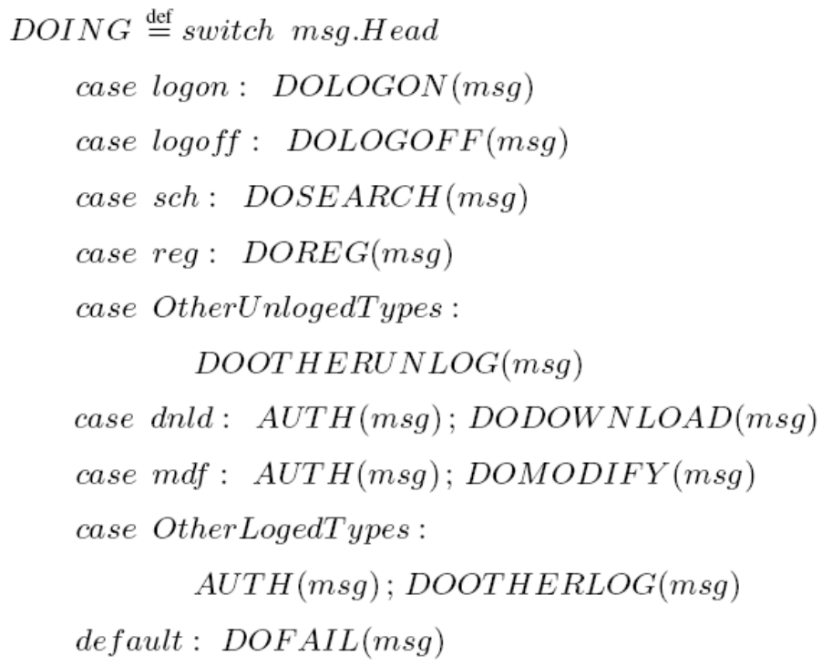
Dispense
Dispense requests to corresponding processes
Define as a choice depending on the message head

Slide 17
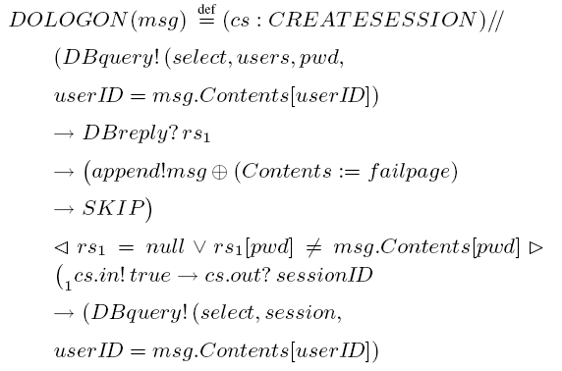
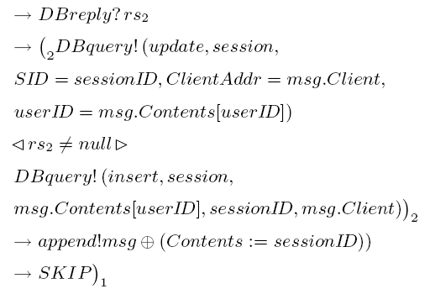
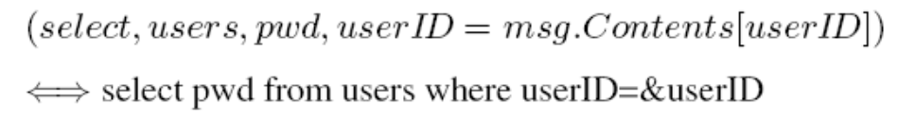
Transaction Processing

Slide 18
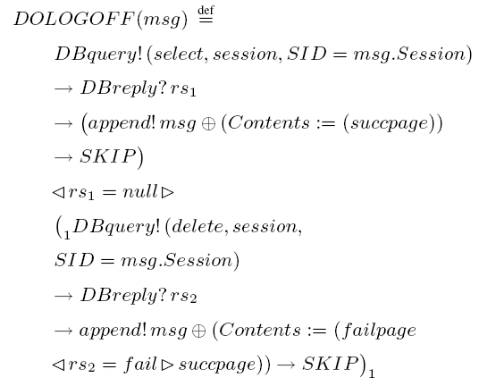
Transaction Processing

Slide 19
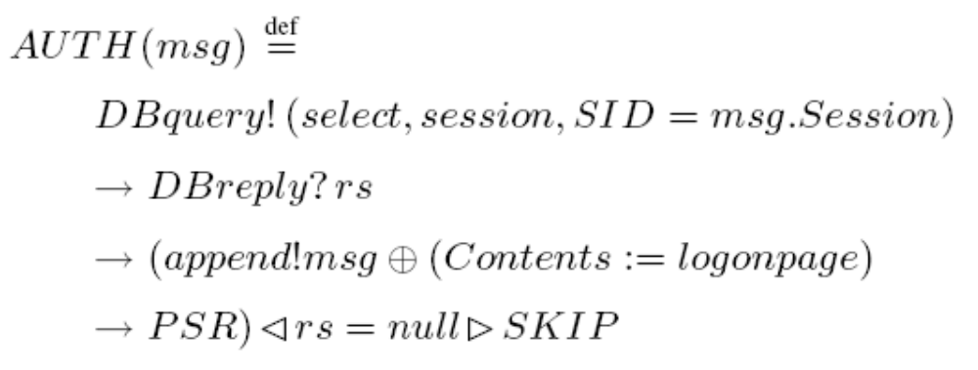
Transaction Processing
Authorize the user’s status with the session table
Session table contains the corresponding user-id, session-id and communication channels

Slide 20
Analysis
Considering the environment
Cases which cause inconsistencies
Mechanisms to fix them

Slide 21
Environment
cost(RECBUFFER) denotes the mean time cost for the RECBUFFER process to receive the messages
cost(PSR) denotes the mean time cost for the PSR process to solve the request
cost(SENDBUFFER) denotes the time cost for the SENDBUFFER sending a response
inconsistencies probably occur when

Slide 22
Cases causing inconsistencies
The server has made a response to the request from the user, but the response does not reach the browser or the browser has already given up waiting for it. Then the browser maintains its state while the server believes that the request has been solved.
The user changes to another browser without logging off through the former one. The former browser remains its state. It may be convenient for others to access the restricted services, which causes the failure.

Slide 23
Mechanisms
TIMER fixes the deadlock
Session field identifies the valid communication
BROWSER & LOGEDBROWSER prevents the user acquiring restricted services invalidly
AUTH authorizes the user’s status and controls its access
consistency regains in the next transaction without failure

Slide 24
Conclusion
Formal model for B/S Architecture in CSP
Time properties described in the communications
Mechanisms to fix inconsistent cases
Most important: Do not fear to start
Things become easy when you really do

